Slide 1
COMPS-B | PROJECT PRESENTATION
Multimodal Accessibility Tool for Visually Impaired People
An AI-powered, voice-driven screen reader and navigation assistant
Kshitij Patil | Comps-B | 14
Harsh Patil | Comps-B | 10
Krish Patil | Comps-B | 13

Slide 2
PROBLEM STATEMENT
The Digital Barrier
Scale of the Problem
Limitations of Existing Tools
Independence Gap
285 million+ people worldwide are visually impaired (WHO, 2023)
Users cannot independently fill forms, click buttons, or navigate modern websites
Existing screen readers only read plain text — they cannot understand images, buttons, or layouts
Cost Barrier
Missing Integration
Licensed tools like JAWS cost ₹50,000+ — unaffordable for most users
No free tool combines visual understanding, speech, and automated UI interaction

Slide 3
OBJECTIVES
What We Set Out to Achieve
01
02
Capture and understand the full visual context of any computer screen using AI
Narrate the screen in natural, human-like language to the user
03
04
Accept a voice command after narration and interpret user intent
Locate the requested UI element on screen using OCR
05
06
Automatically perform the action (click) on behalf of the user
Build a free, lightweight tool that works on any Windows PC

Slide 4
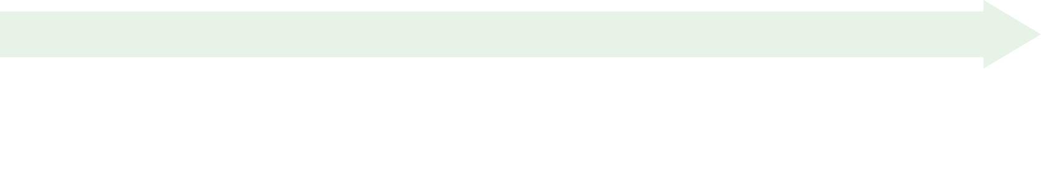
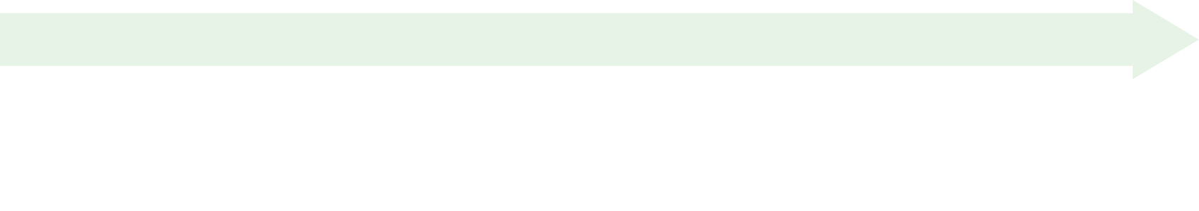
METHODOLOGY
System Design & Approach
Step 2 — AI Vision Analysis
Step 1 — Screen Capture
Screenshot sent to a Multimodal Vision LLM (Google Gemma 4 via OpenRouter)
AI prompted to describe screen like a human guide — layout, buttons, fields, context
Triggered by hotkey (Ctrl + Alt + S)
Screenshot captured and compressed
Step 4 — Voice Command Input
Step 3 — Text-to-Speech Narration
Microphone activates automatically after narration ends
User speaks one command (e.g. "Click the login button")
Speech captured and transcribed using Google STT
AI description spoken aloud using Windows native SpeechSynthesizer
Step 6 — UI Automation
Step 5 — Intent Parsing + OCR Grounding
Mouse moves to the coordinates and clicks the element (PyAutoGUI)
System speaks: "Okay… Done"
AI extracts target element name from the voice command
Windows Native OCR scans the screenshot and finds the element's screen coordinates

Slide 5
IMPLEMENTATION
Technologies Used
Module | Technology
Screen Capture | Python — Pillow (PIL)
Multimodal AI | Google Gemma 4 (OpenRouter API — Free)
Text-to-Speech | Windows PowerShell SpeechSynthesizer
Speech-to-Text | Google STT + SoundDevice
OCR (UI Grounding) | Windows Native OCR (WinRT)
UI Automation | PyAutoGUI
Hotkey Trigger | Keyboard library
Configuration | Python-dotenv
Key Implementation Highlights
Custom SoundDeviceMic adapter — bypasses PyAudio Windows build errors
One-shot listener design — captures one command, acts, then shuts off
OCR used for spatial grounding instead of asking AI for pixel coordinates (more accurate)
Entire solution runs on free APIs — zero cost to the user

Slide 6
RESULTS
What the System Achieved
✅ Screen Narration
✅ Voice Command
✅ UI Action
Screen narrated in natural human language within ~10 seconds of hotkey press
Voice command transcribed and element located in under 3 seconds
Mouse automatically moved and clicked the correct UI element
✅ Verbal Confirmation
✅ Tested Successfully On
System confirmed actions verbally ("Okay" and "Done")
Login pages, search bars, navigation tabs, buttons
Accuracy
Narration Relevance
OCR Element Grounding
Voice Recognition
Highly accurate for standard UI layouts
Accurate for clearly visible text-based elements
Accurate in quiet environments
Future Enhancements
Regional language support, mobile app, offline AI mode, and browser extension planned

Slide 7
CONCLUSION
Summary
Successfully built a multimodal AI accessibility tool that sees, speaks, listens, and acts
Combines computer vision, NLP, speech recognition, OCR, and UI automation
Enables visually impaired users to navigate any screen using only their voice
Free, lightweight, and runs on any Windows PC with no special hardware
Supports Digital India Mission — empowering 15M+ visually impaired Indians with free, independent digital access
A meaningful step toward making digital technology truly inclusive
"We did not build a workaround. We built equal access."

Slide 8
REFERENCES
References
WHO (2023) — World Report on Vision
OpenRouter API — openrouter.ai
Windows WinRT OCR — Microsoft Docs
PyAutoGUI — pyautogui.readthedocs.io
SpeechRecognition Library — pypi.org/project/SpeechRecognition

Slide 9
Thank You
Multimodal Accessibility Tool for Visually Impaired People
Kshitij Patil | Harsh Patil | Krish Patil
Comps-B

